Slide 1
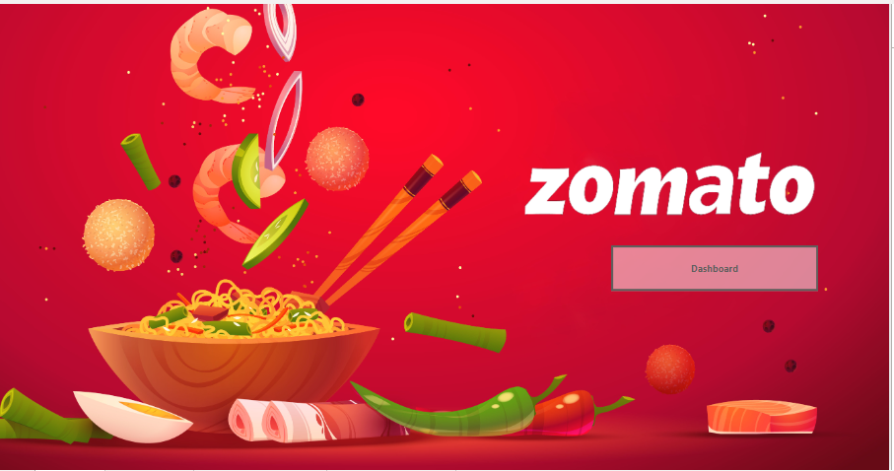
ZOMATO SALES POWER-BI DASHBOARD
BY RAPAKA MANOJ KUMAR

Slide 2
CONTENTS
AIM OF THE PROJECT
Key objectives
Dataset
Challenges
Findings
Recommendations
Output pages
Conclusion

Slide 3
Aim of the project
Categorize and analyze food items to understand the variety and popularity across different cuisines.
Investigate sales performance to identify trends and patterns that can drive business decisions.
Assess customer satisfaction and engagement to enhance user experience and retention.
Explore the geographic distribution of restaurants to uncover opportunities for strategic growth and expansion.

Slide 4
Key objectives
Categorized food items and analysed cuisine variety
Investigated sales trends and restaurant distribution
Assessed customer satisfaction and engagement
Visualized geographic insights for strategic growth

Slide 5
DATA SETS
FOOD DATA SET- f-id, item, veg-or-non-veg
MENU DATASET- r-id , f-id,cuisine,price
ORDERS DATASET- salesqty,sales-amount ,currency, user_id ,r-id
RESTAURANT DATA SET- name, country ,city ,rating ,rating count ,cuisine ,link ,address
USERS DATASET -user_id,name,age ,gender,marital status,occupation

Slide 6
Challenges of the Project
Corrected header issues in the food dataset and merged it with the menu dataset.
Replaced null values in the datasets with appropriate substitutes.
Unpivoted the orders dataset to filter amount and quantity effectively.
Applied DAX functions and used visual elements like bar charts, line charts, and filters.

Slide 7
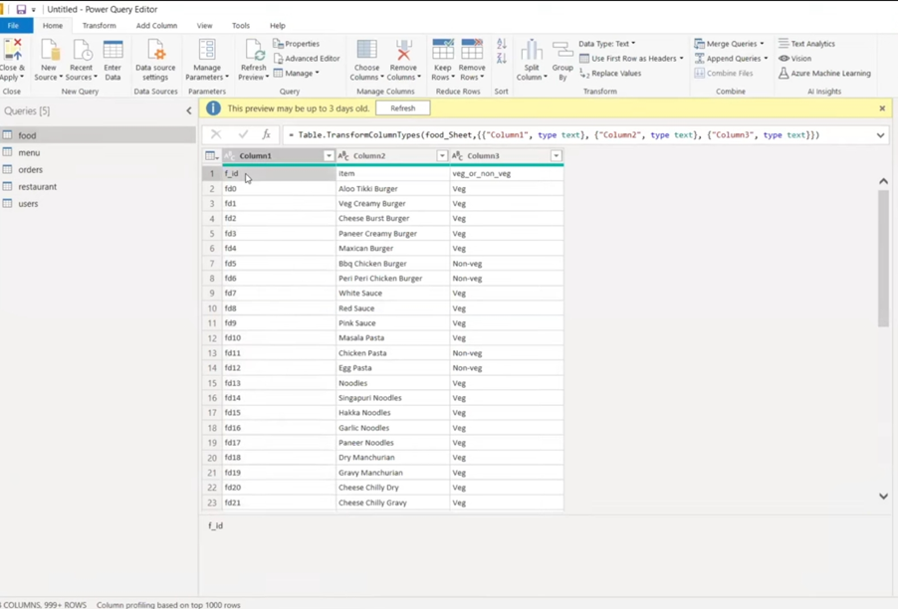
CHALLENGES IN ZOMATO SALES DATA SET
1) Food dataset not loaded correctly use first row as headers

Slide 8
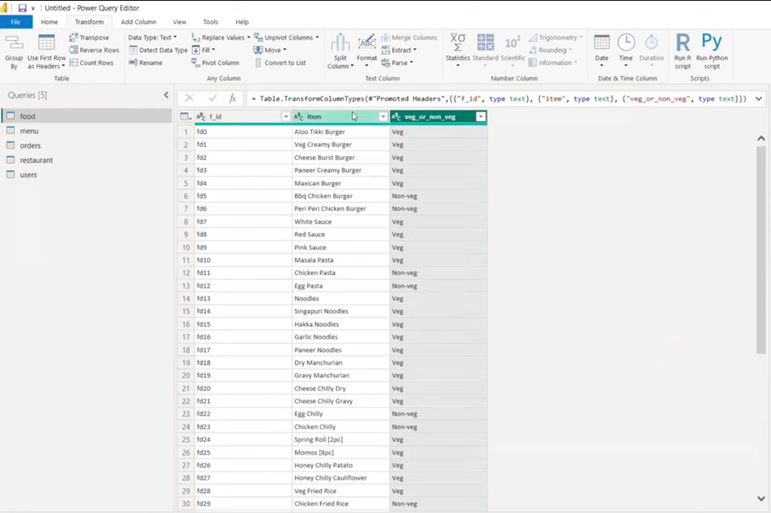

Slide 9
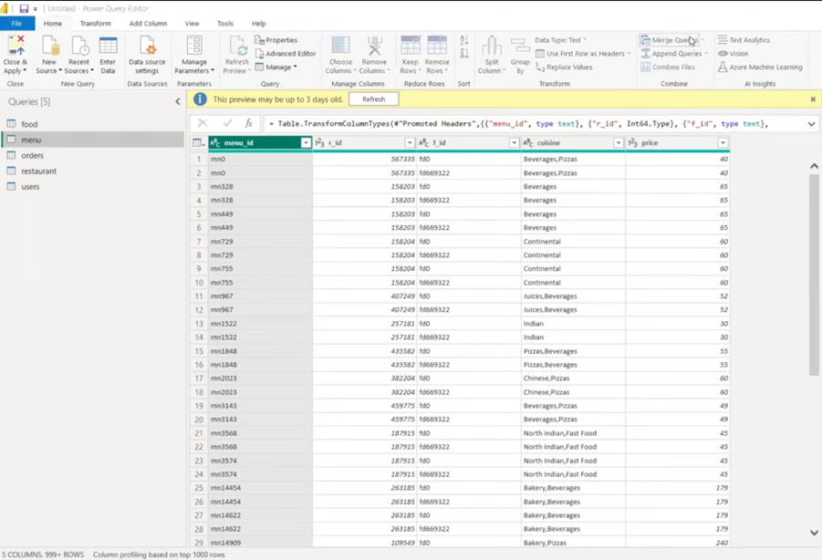
2) challenge merge menu data with food data

Slide 10
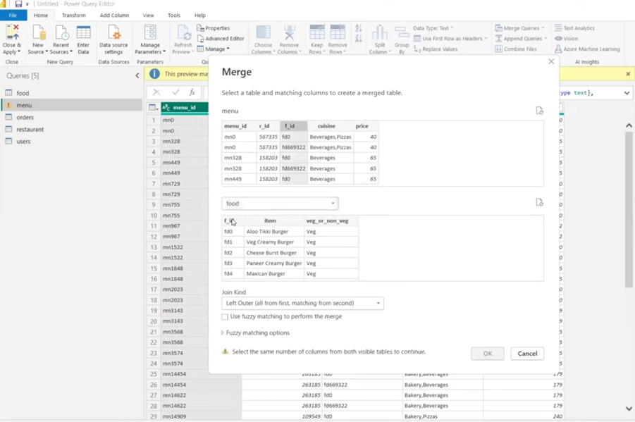

Slide 11
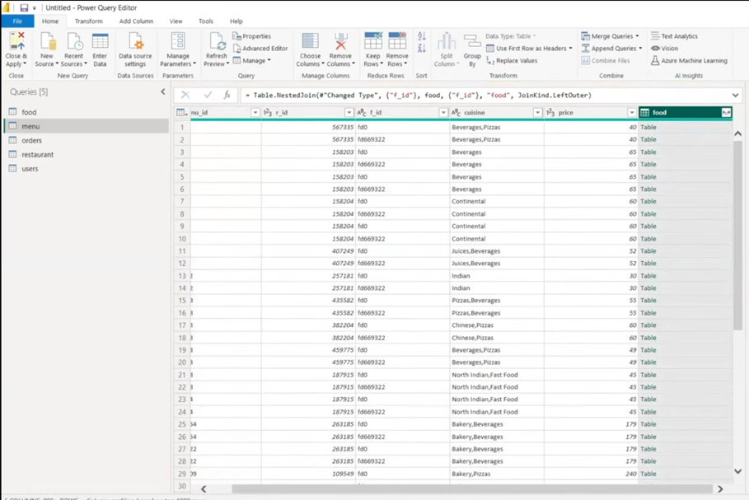

Slide 12
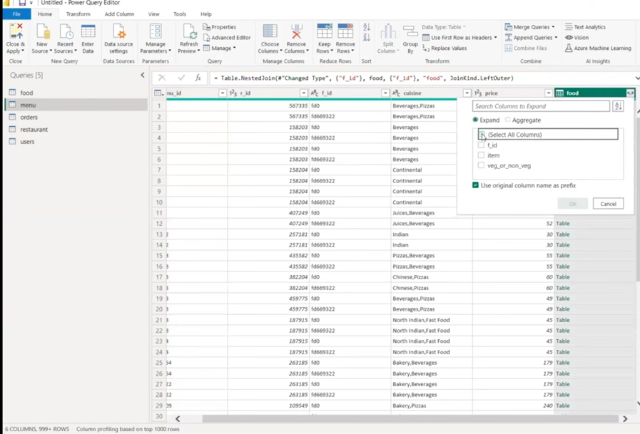

Slide 13
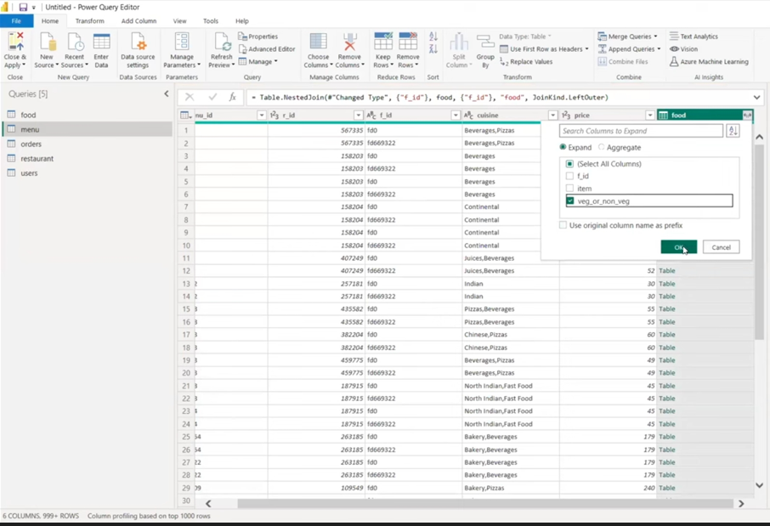

Slide 14
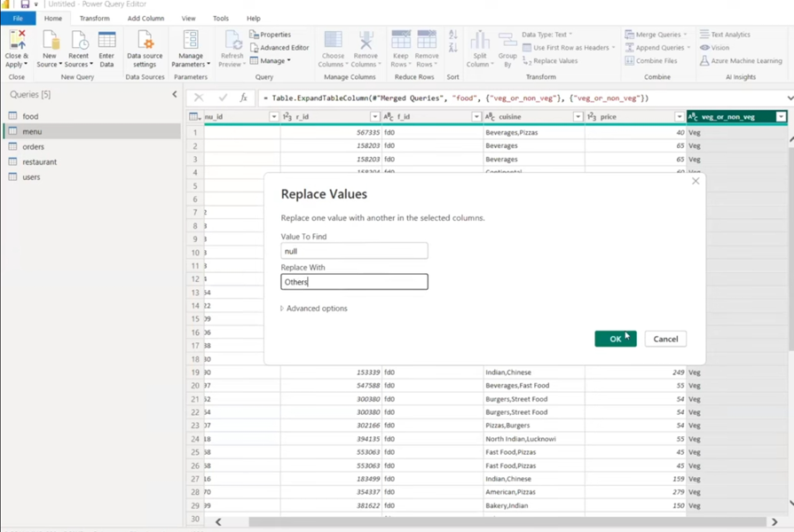
3)Replace null values with others

Slide 15
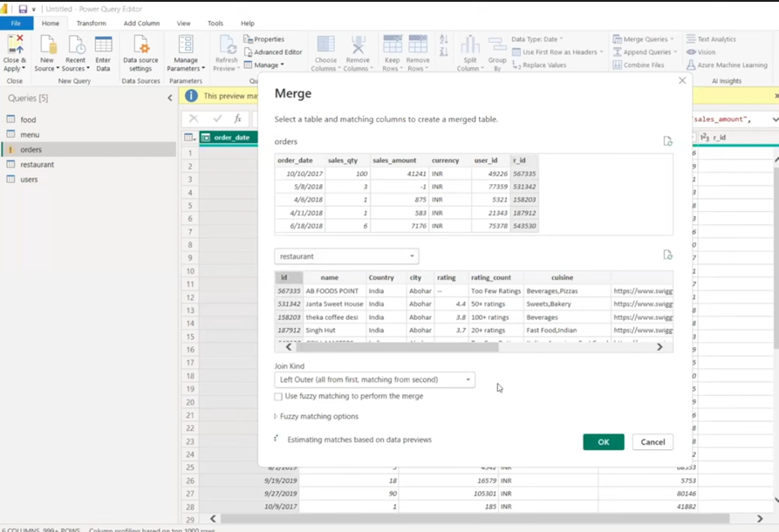
4)Merging order data with restaurant data

Slide 16
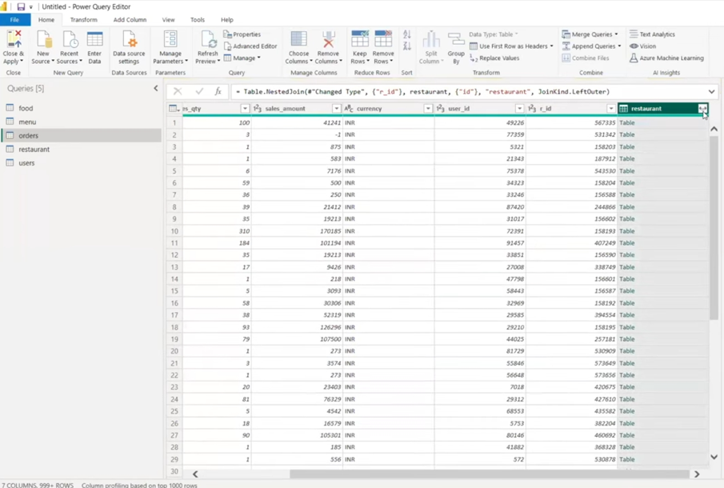

Slide 17
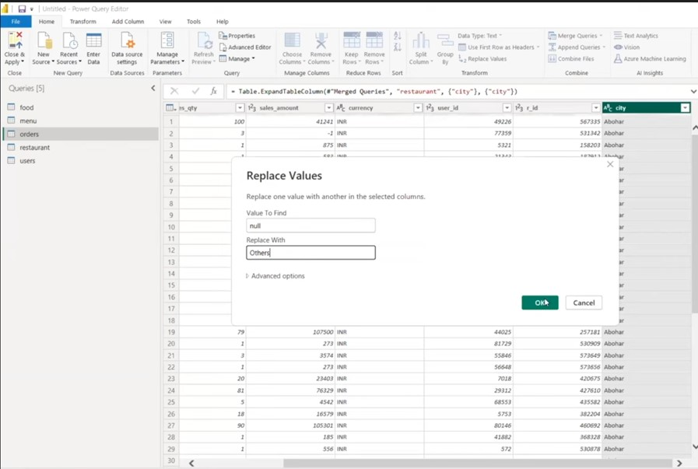
5) Replacing with null value with others

Slide 18
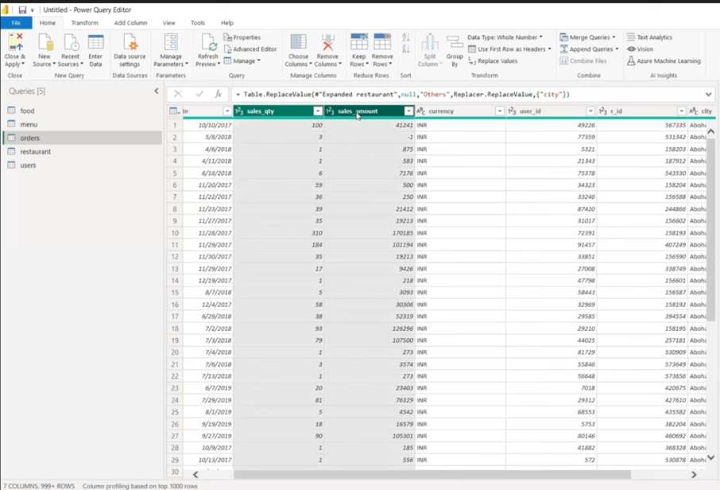
6) To filter AMOUNT and QUANTITY I have to unpivot orders sales_qty and sales_amount

Slide 19
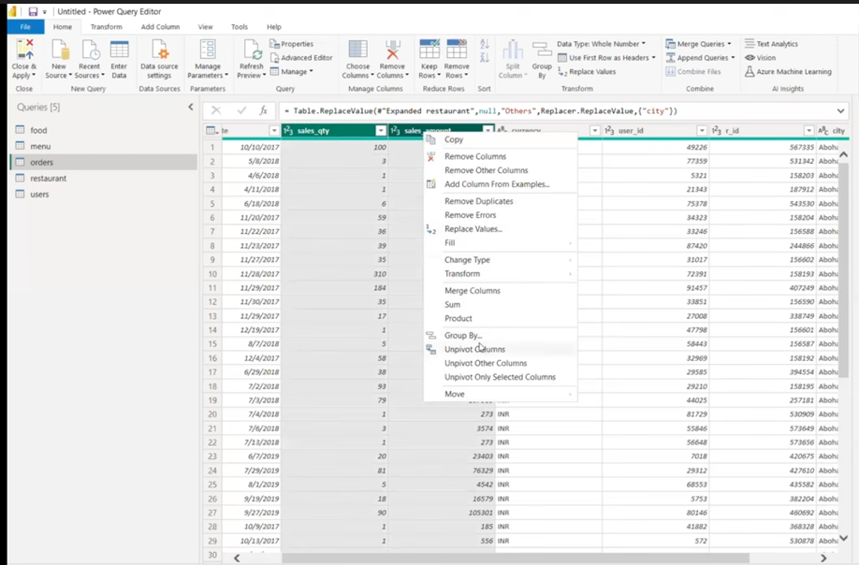

Slide 20
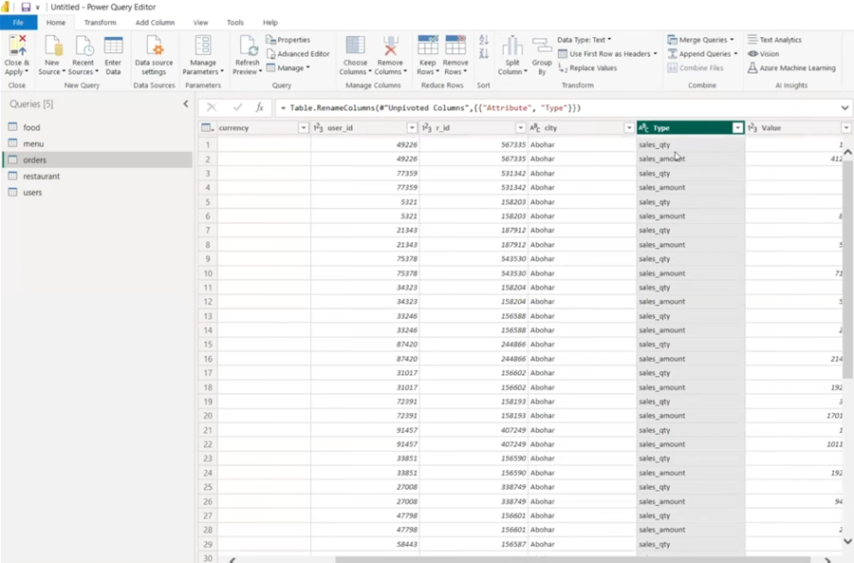
7) changing attribute column in orders data set to sales_qty to Quantity and Sales_amount to Amount

Slide 21
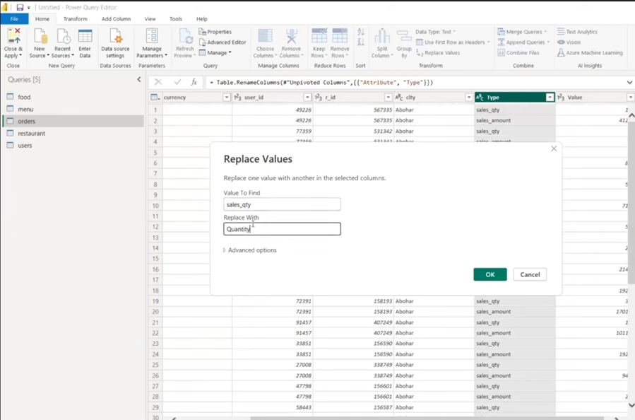

Slide 22
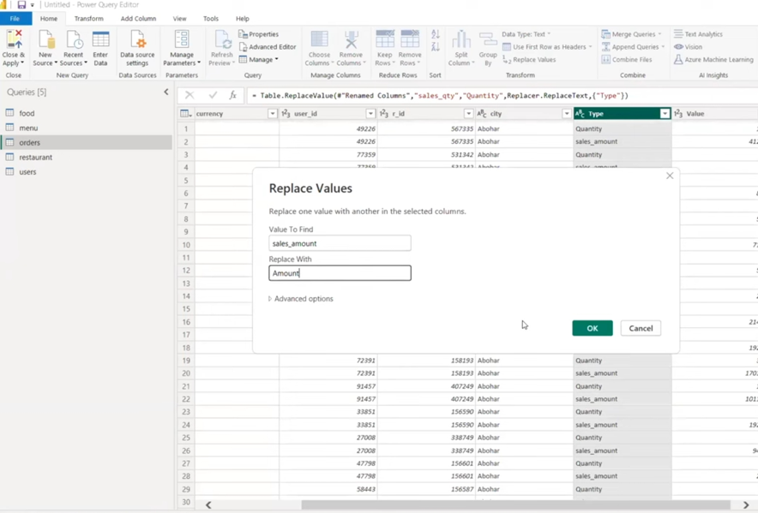

Slide 23
Findings
Top-performing cuisines and popular restaurant types
Insights on customer preferences and engagement metrics
Opportunities for expanding popular menu items and optimizing restaurant locations

Slide 24
𝐑𝐞𝐜𝐨𝐦𝐦𝐞𝐧𝐝𝐚𝐭𝐢𝐨𝐧𝐬:
Expand offerings in popular cuisine categories
Enhance marketing strategies based on customer reviews
Optimize menu based on sales trends
Focus on high-performing locations for growth
Implement customer feedback loops for continuous improvement

Slide 25
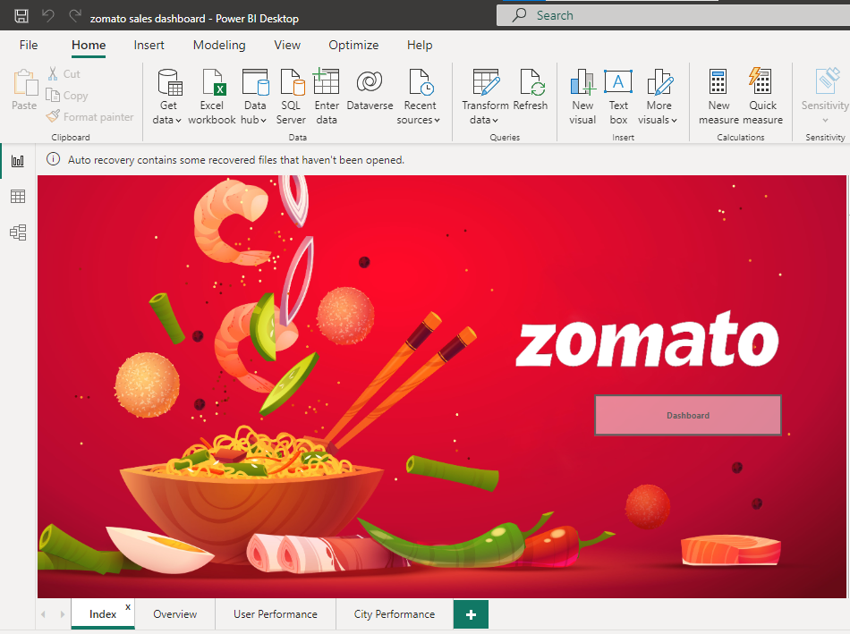
INDEX PAGE

Slide 26
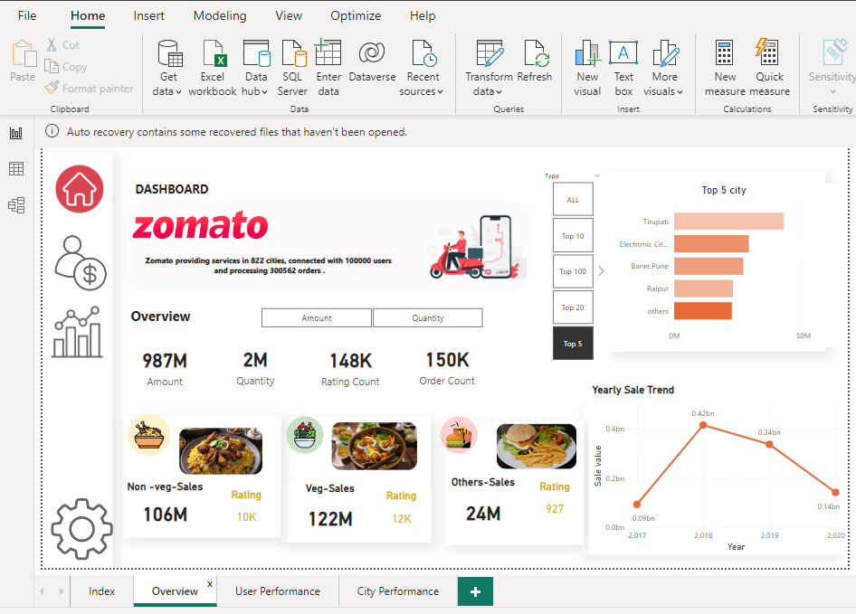
OVERVIEW PAGE

Slide 27
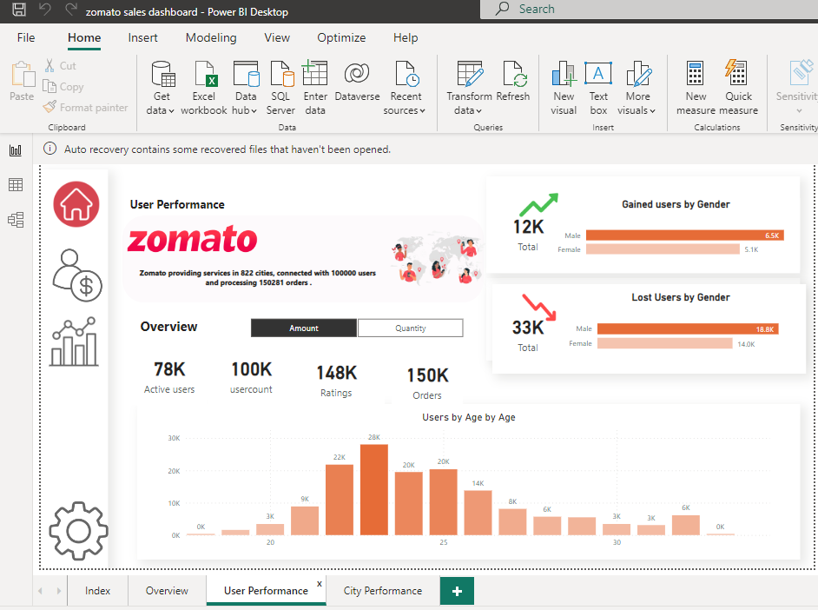
USER PERFORMANCE PAGE

Slide 28
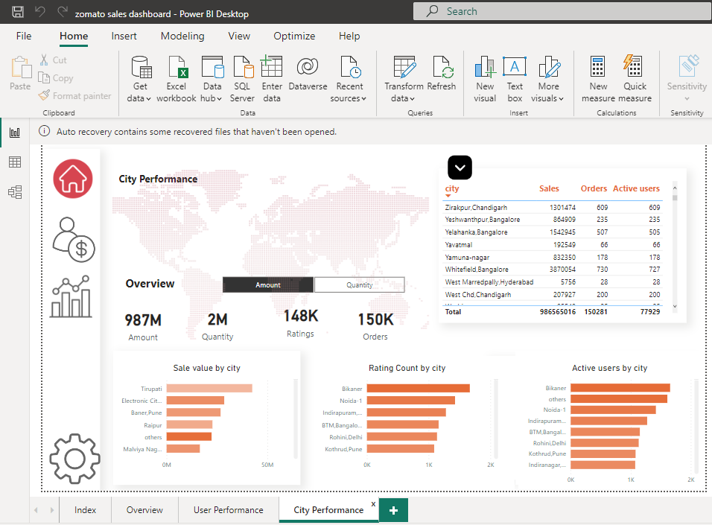
CITY PERFORMANCE PAGE

Slide 29
CONCLUSION
The project provided actionable insights into cuisine preferences and sales distribution.
Challenges were addressed through data preprocessing, merging, and visualization techniques.
The analysis highlighted areas for strategic growth and operational improvement.
The dashboard served as a valuable tool for decision-making and future planning.

Slide 30
THANK YOU

